Slide 1

HOW TO MAKE TECHNICAL DECISIONS?

Slide 2
Examples
Docker swarm
Kubernetes
MongoDB
MySQL
Maven
Gradle
implement
reuse
Notes:
TODO: Under 1 minutes

Slide 3
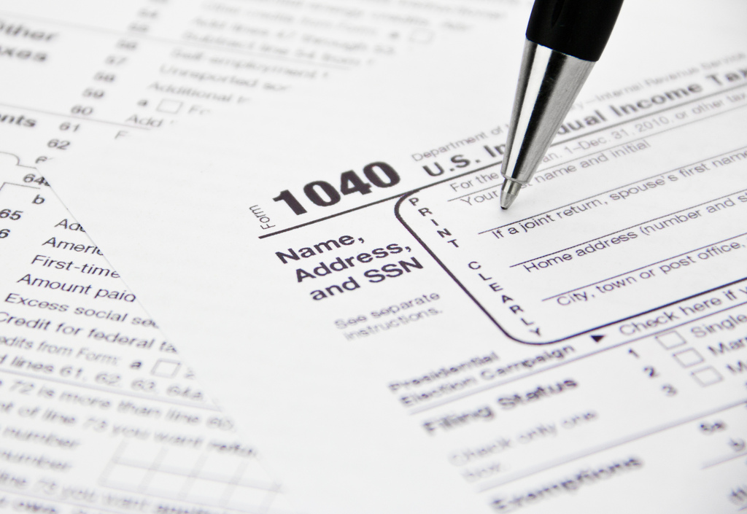
your WORST technical decision here

Slide 4
… let me help
own persistency layer
in PHP
merge two
non-compatible libraries
~ 300 dependencies each

Slide 5

We all have war stories
“… let’s implement our own
FRAMEWORK
for that!!!

Slide 6
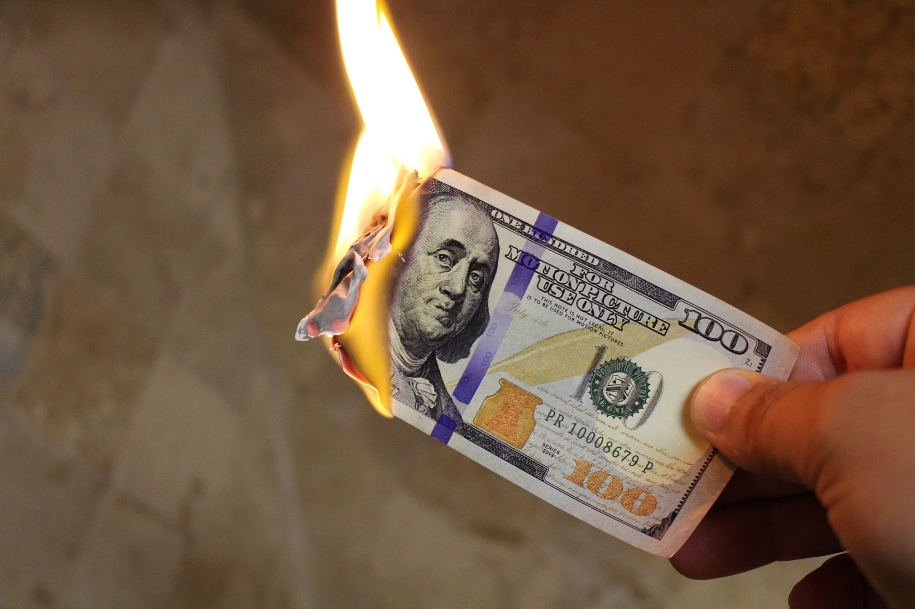
Notes:
COST OF A BAD DECISION

Slide 7




STICKY
COGNITIVE NOISE
TECHNICAL DEBT
ACCIDENTAL COMPLEXITY
Notes:
Cognitive Noise OWN STORY: 3 syntactic sugar libraries for same purpose (commons, guava)
TODO: 1:30
(PAUSE)

Slide 8


Slide 9

SOLVES THE RIGHT PROBLEM

Slide 10
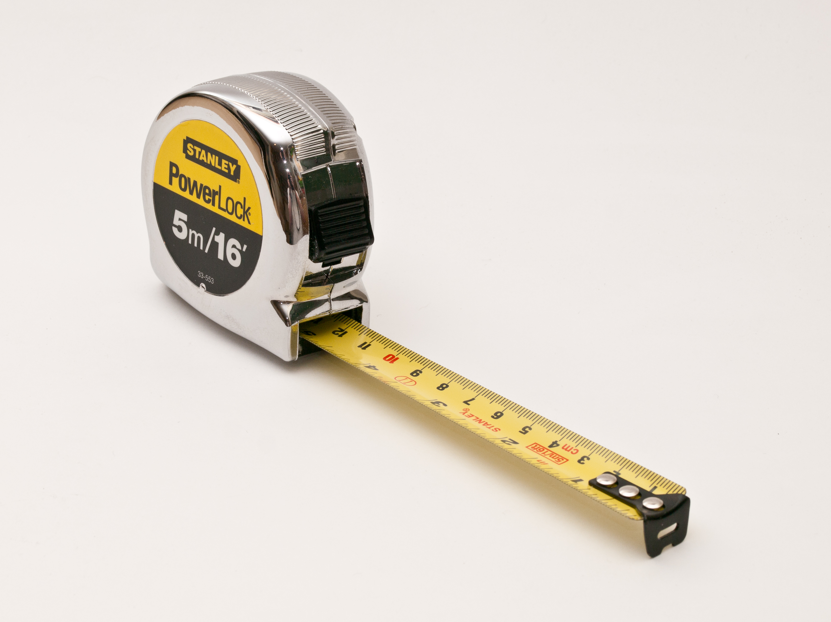
METRICS
S
Notes:
POLL!!!

Slide 11
What metrics would you use to aid your technical decisions? (11)
Roi
Class fan out compl.
time
What's the effort (dev-tim) required to revert it or use something else
Number of pros vs cons, feedback from communities/ppl.
Tech debts introduced (in days) / time to implement
added transitive dependencies
Size of community supporting that stuff
number of successful projects using the same technology
Commit rate
Maturity
Performance degradation
NPath complexity

Slide 12

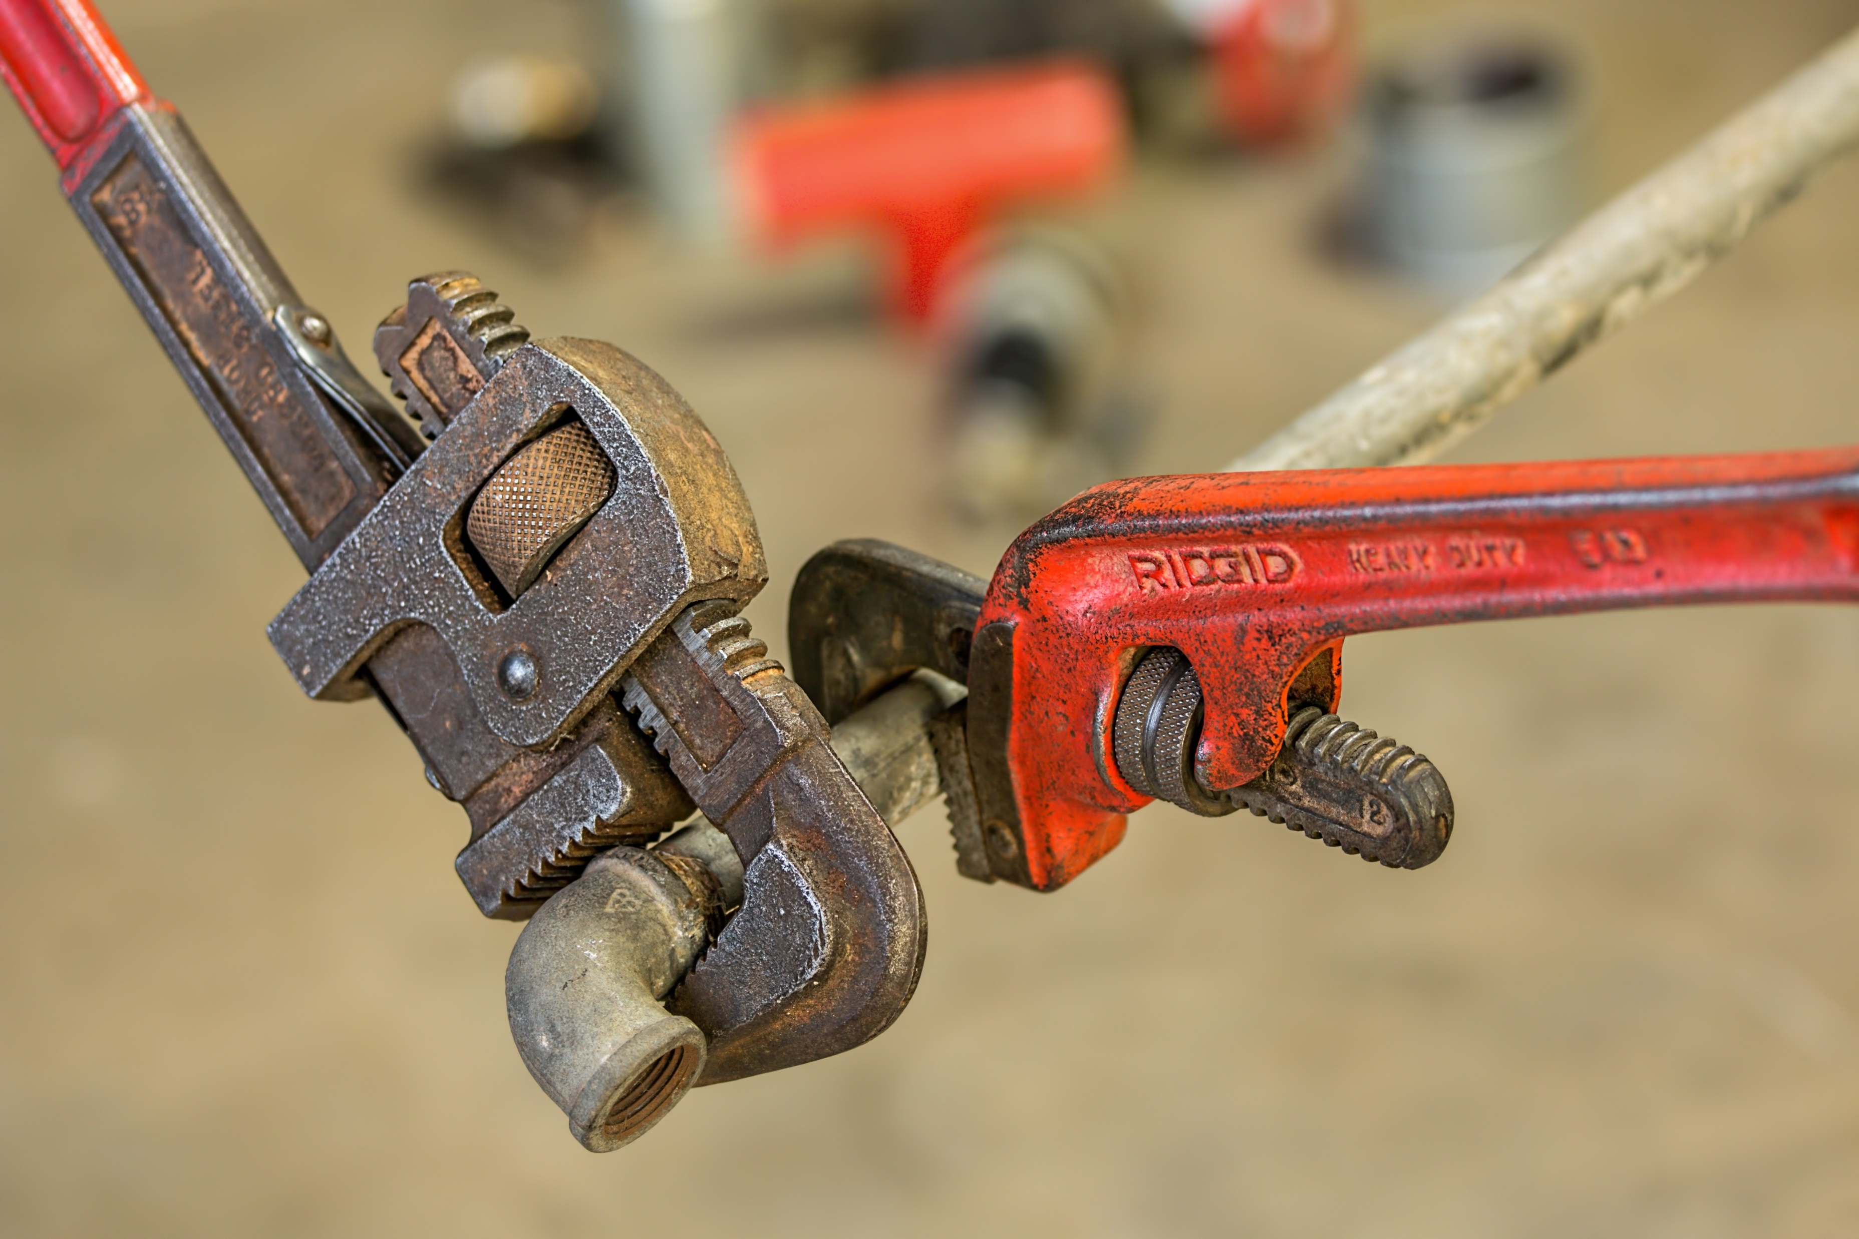


EASY TO USE
MAINTAINABLE
FAST
NO SURPRISES

Slide 13
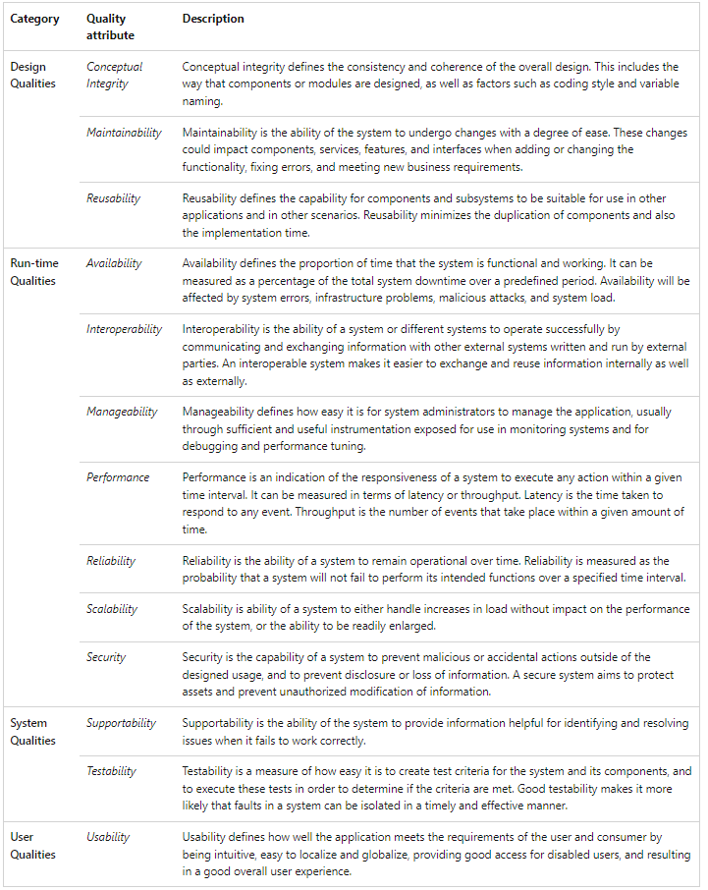
Quality Attributes
& Metrics
Could take weeks
Expertise to do it rapidly
Prioritization!
Just enough depth of field

Slide 14
Learning
Curve
Design
Support
Runtime

Slide 15
API
maturity
Design
simplicity
feature
richness
interfacing
(replaceable)

Slide 16
quality
docs
usability
Learning
Curve
fast feedback
team expertise

Slide 17
technical constraints
no SPOF
performance
Runtime
stability
security

Slide 18
debugging
logging
exceptions
monitoring
Support
testing
no snowflakes

Slide 19
API
maturity
quality
docs
usability
Design
technical constraints
simplicity
Learning
Curve
interfacing
(replaceable)
feature
richness
fast feedback
team expertise
logging
debugging
stability
monitoring
exceptions
Runtime
no SPOF
Support
no snowflakes
performance
testing
security

Slide 20
HOW TO MEASURE?

Slide 21
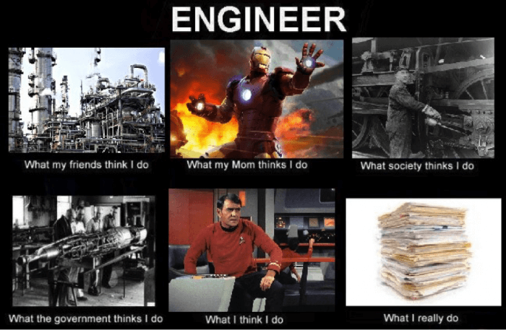
Getting Started

Slide 22
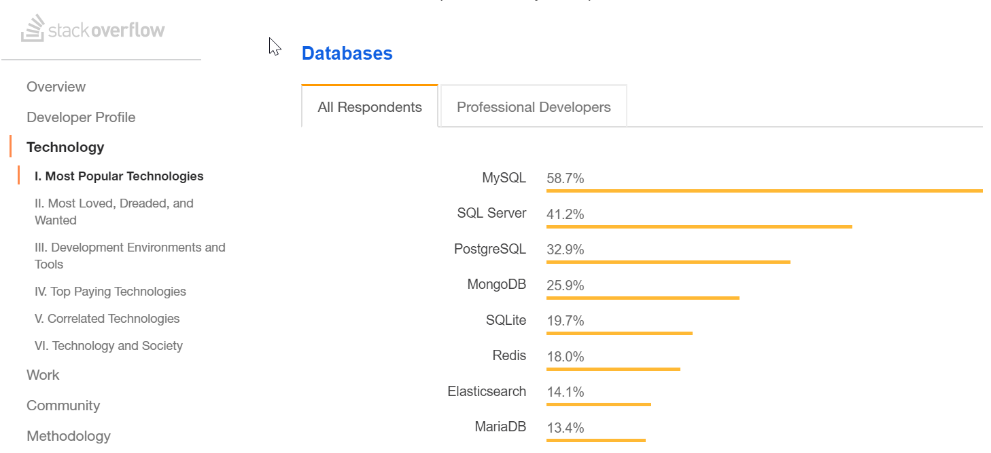
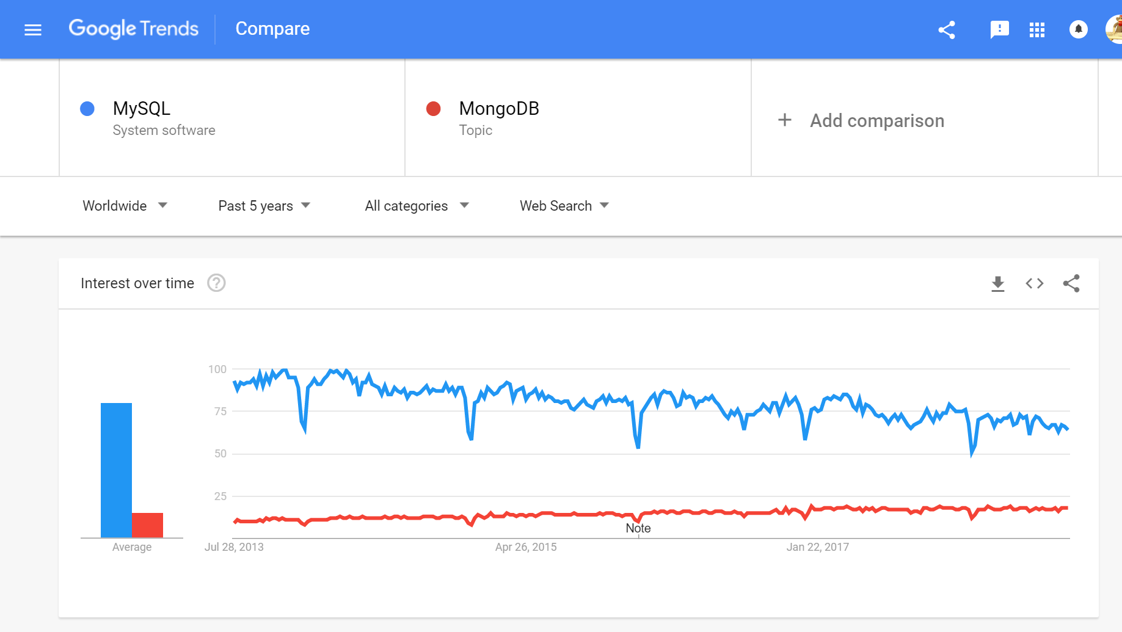
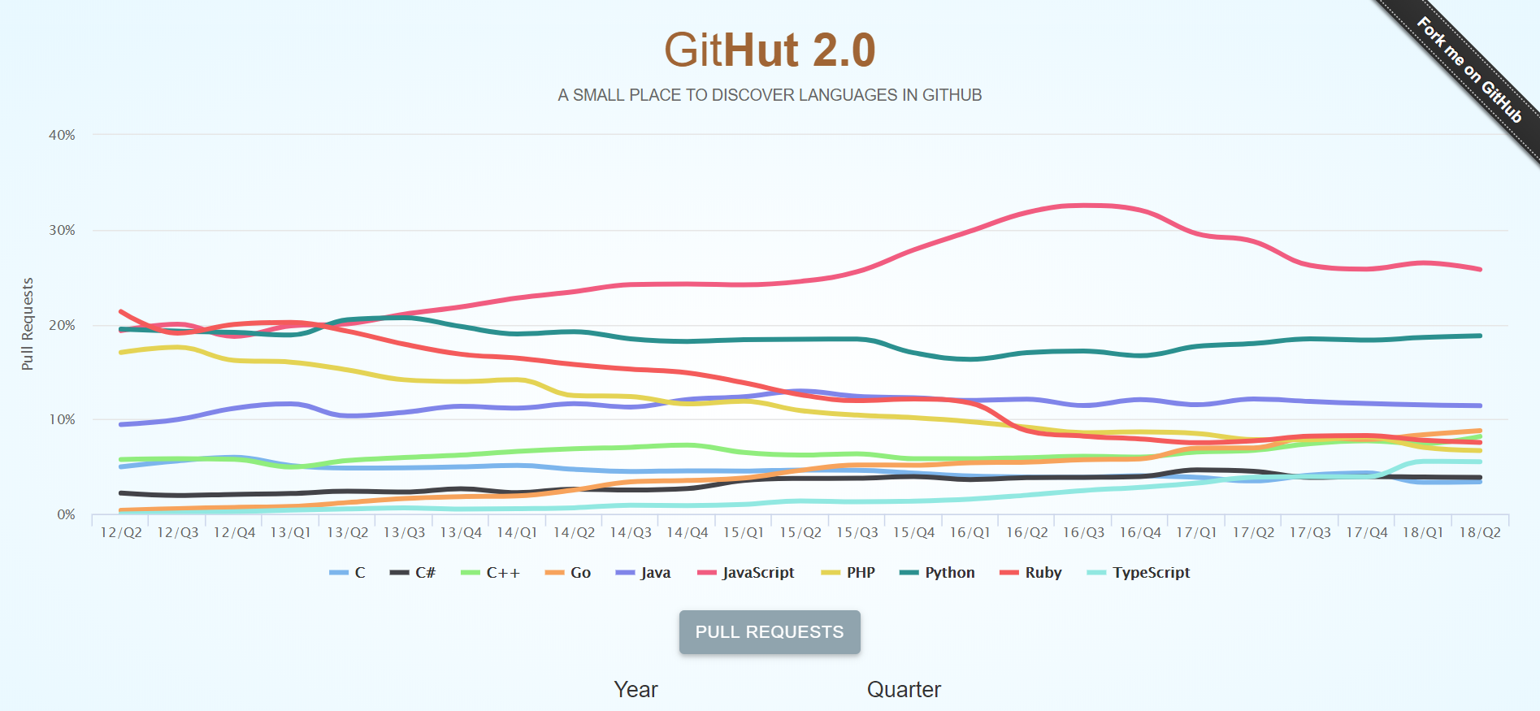
Maturity
Notes:
“how to position your technology stack in the given job market”

Slide 23

Technical Constraints & Feature Richness

Slide 24
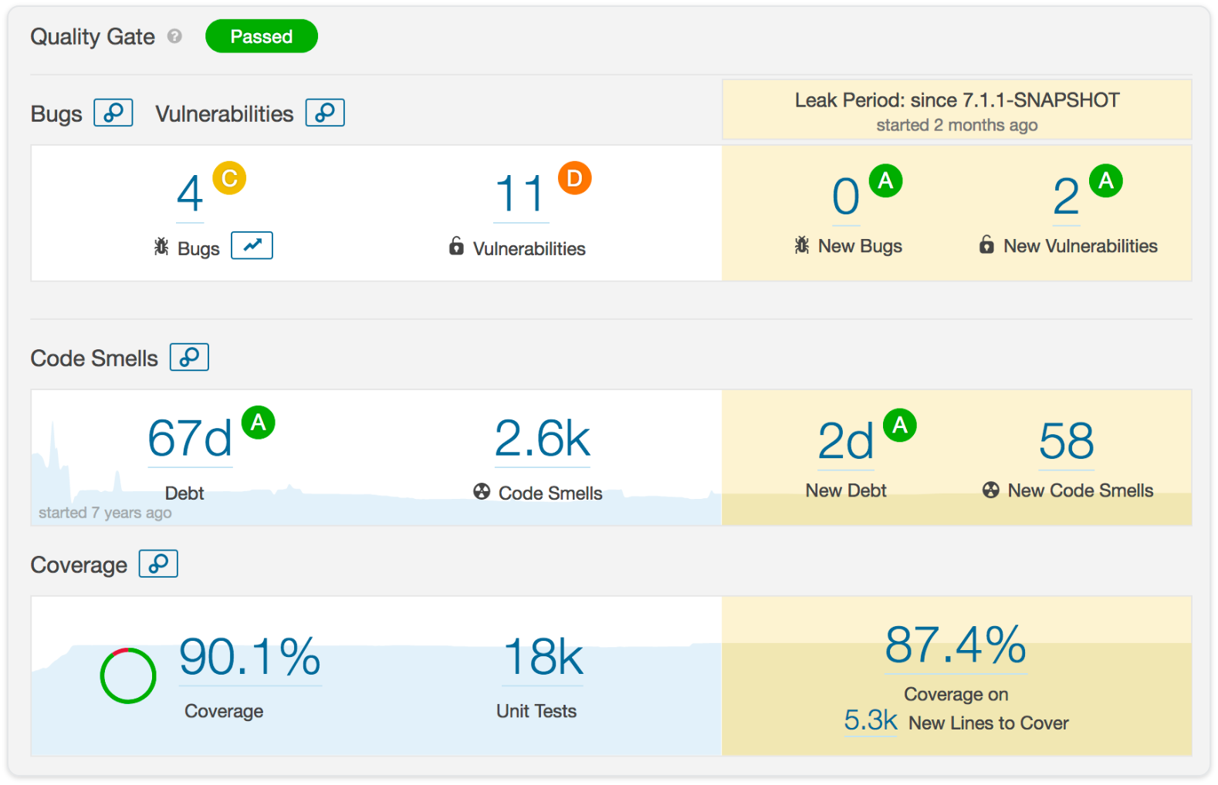
Design & Simplicity & API & Stability

Slide 25
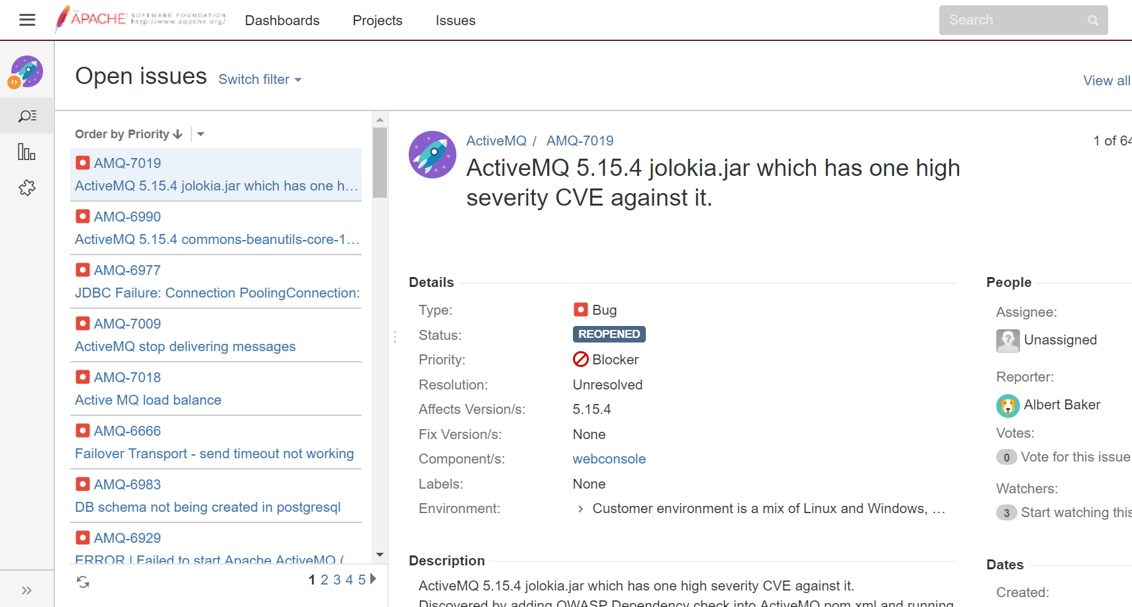
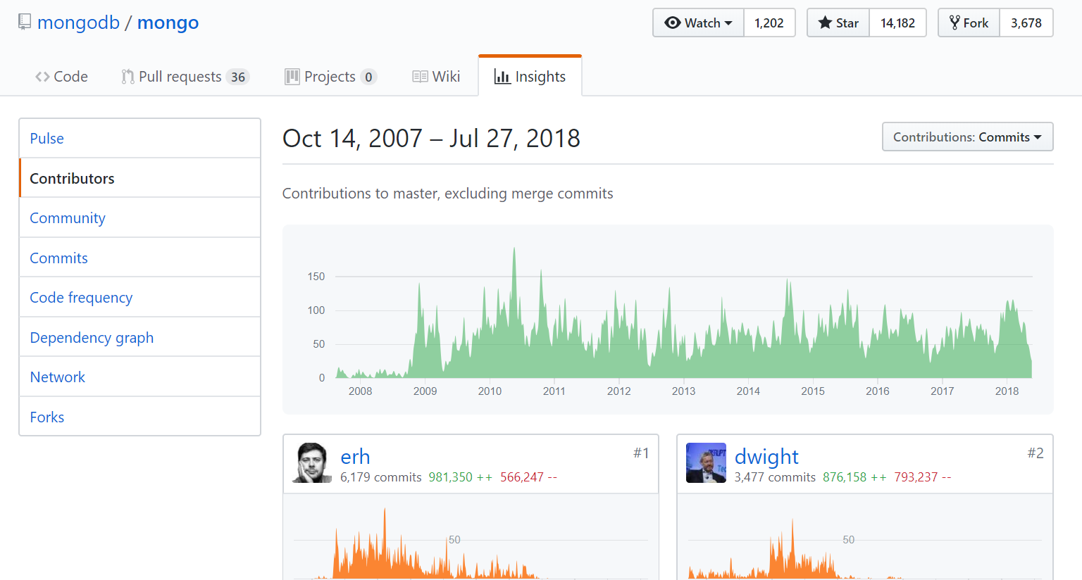
Stability

Slide 26
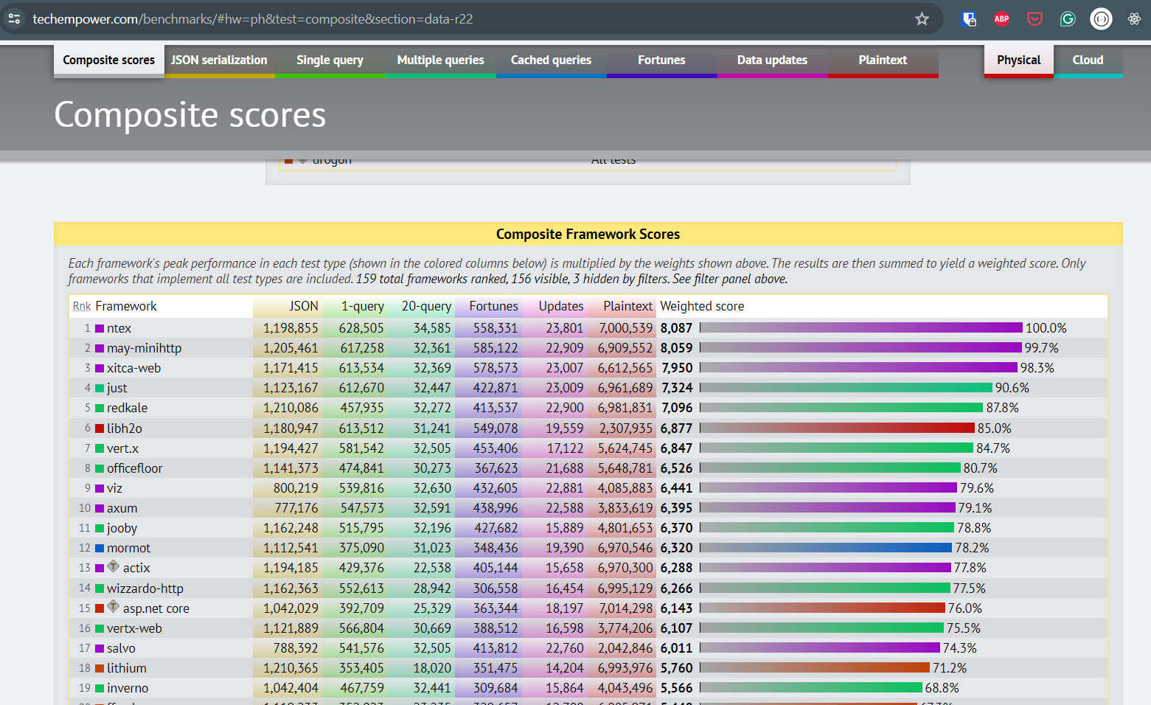
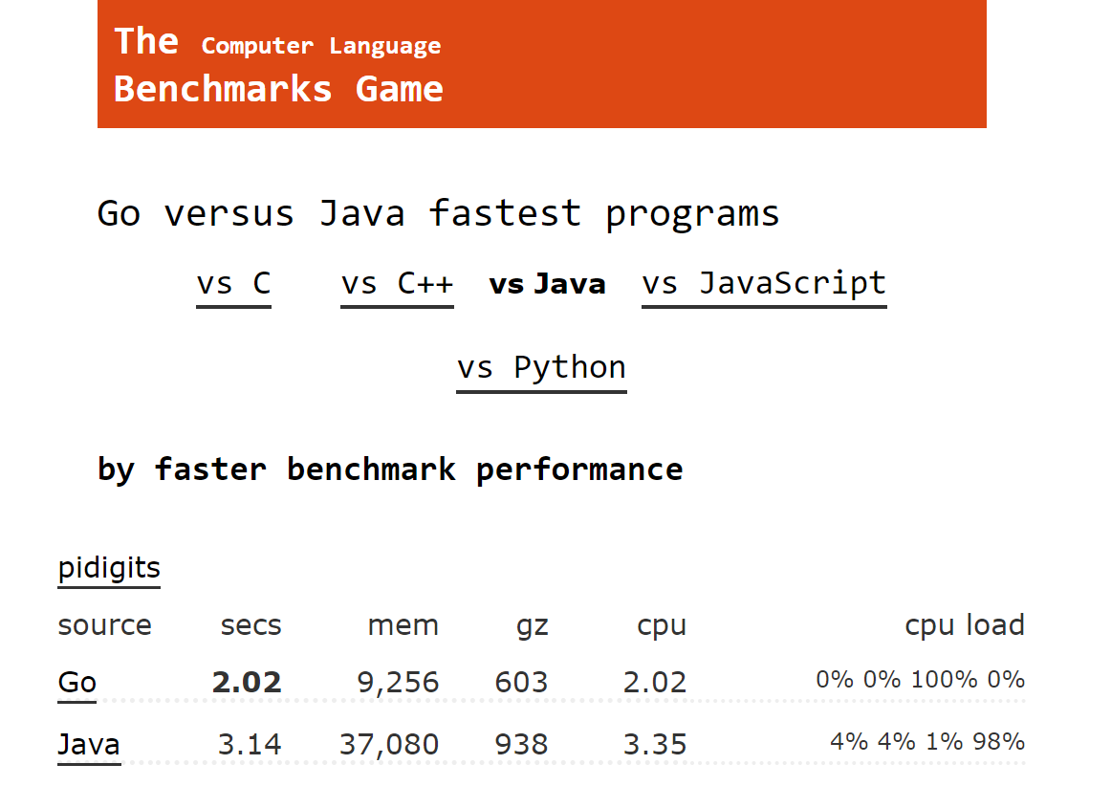
Performance

Slide 27
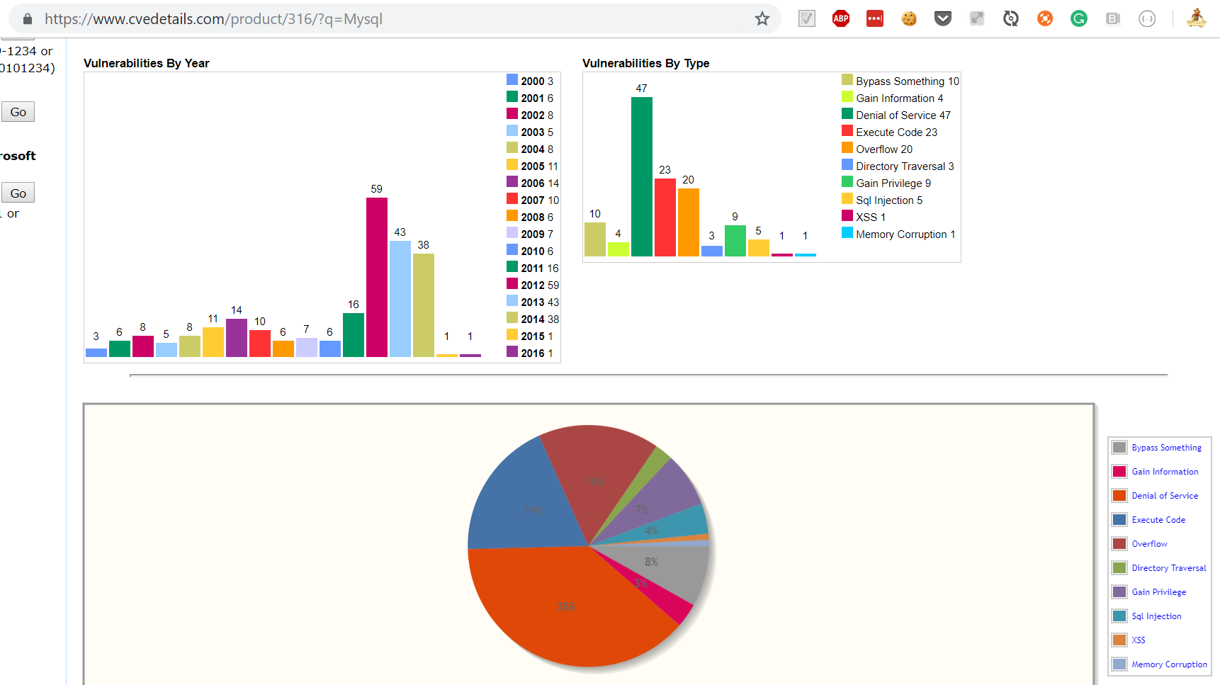
Security

Slide 28


VS
Notes:
3 seconds and 30 seconds make a difference

Slide 29
apiVersion: apps/v1
kind: Deployment
…
spec:
…
template:
spec:
containers:
- name: …
…
---
apiVersion: v1
kind: Service
metadata:
name: mysql
…
version: '3'
services:
toxiproxy:
image: "shopify/toxiproxy"
redis-master:
image: "redis:alpine"
redis-slave:
image: "redis:alpine"
mysql:
image: mysql:5.6
…

Slide 30
API
maturity
quality
docs
usability
Design
technical constraints
simplicity
Learning
Curve
interfacing
(replaceable)
feature
richness
fast feedback
team expertise
logging
debugging
stability
monitoring
exceptions
Runtime
no SPOF
Support
no snowflakes
performance
testing
security

Slide 31
API
maturity
quality
docs
usability
Design
technical constraints
simplicity
Learning
Curve
interfacing
(replaceable)
feature
richness
fast feedback
team expertise
logging
debugging
stability
monitoring
exceptions
Runtime
no SPOF
Support
no snowflakes
performance
testing
security

Slide 32
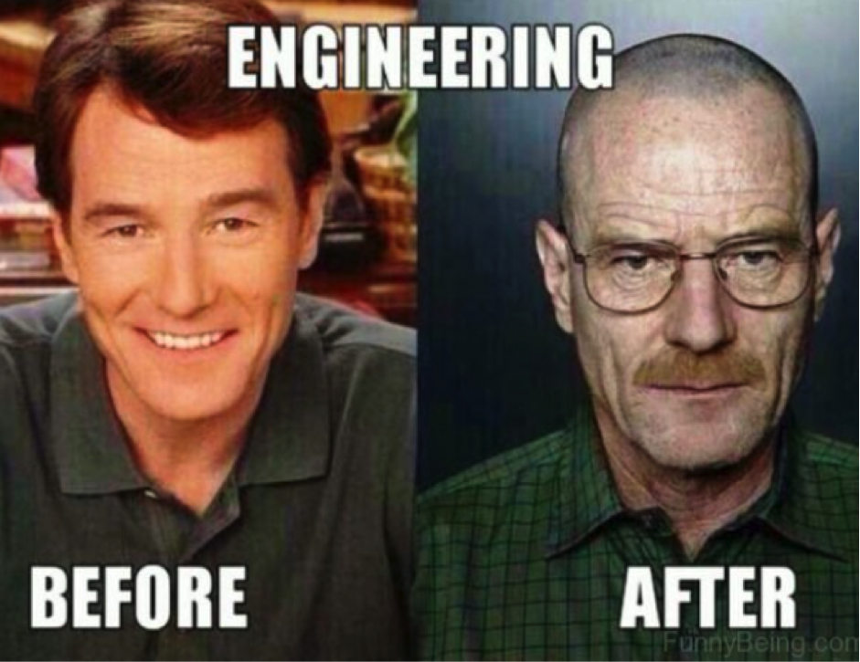
Advanced Techniques

Slide 33
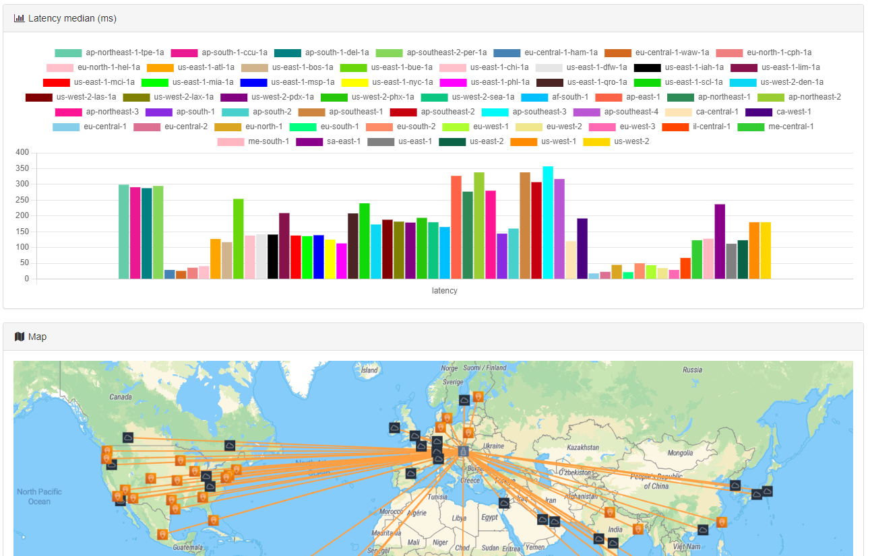
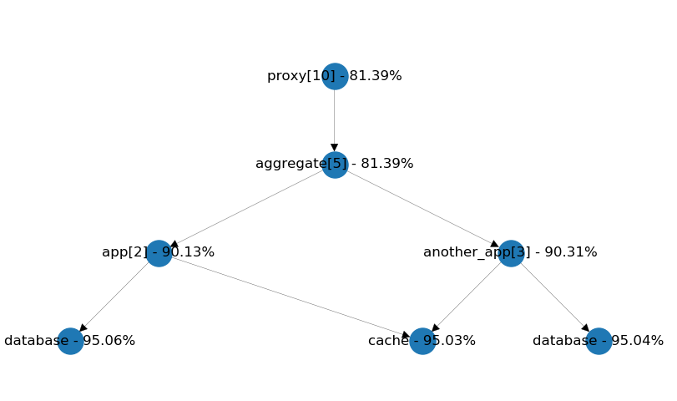
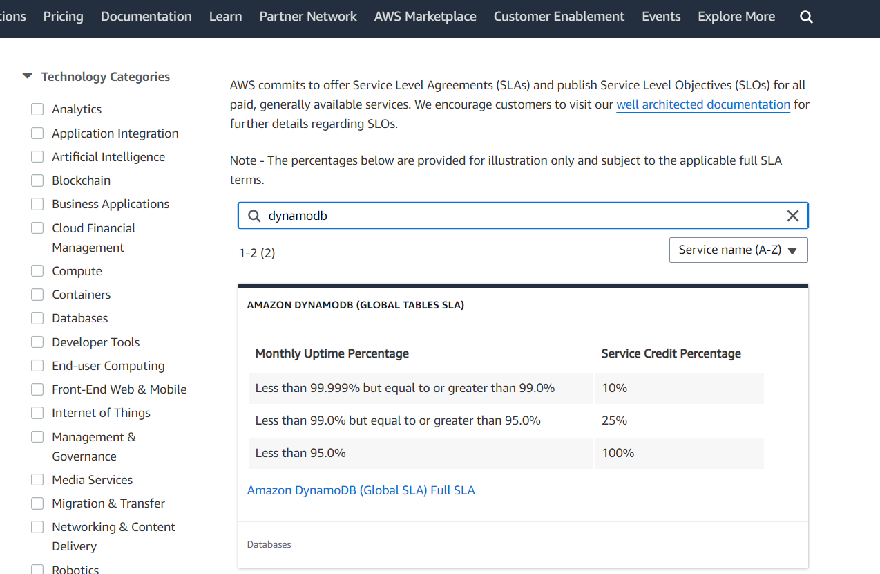
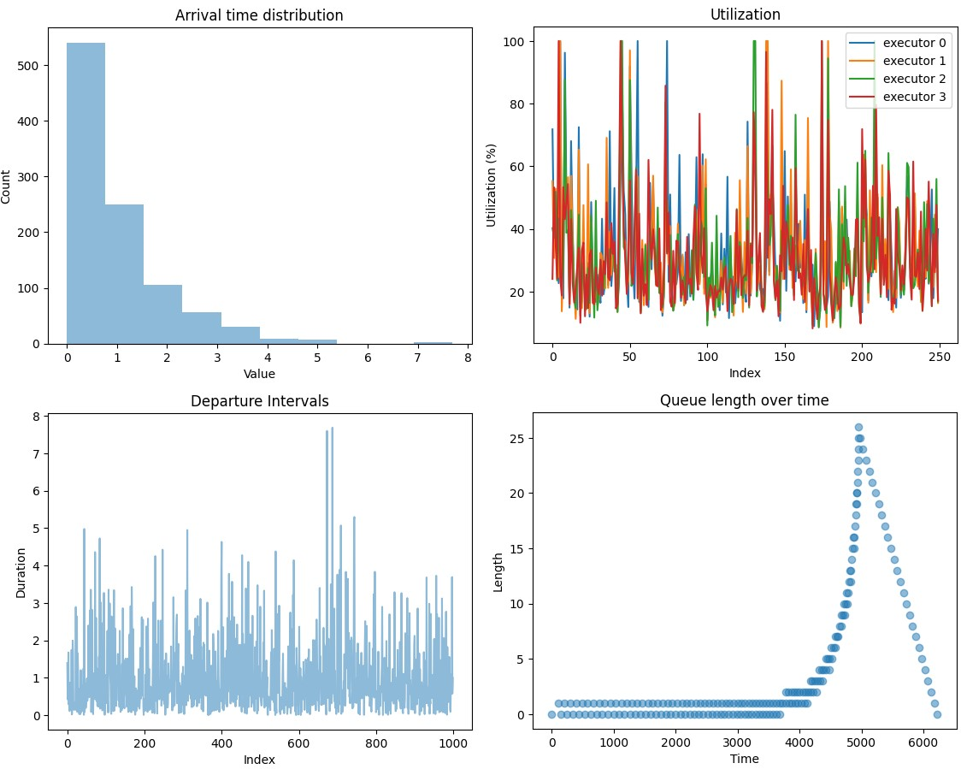
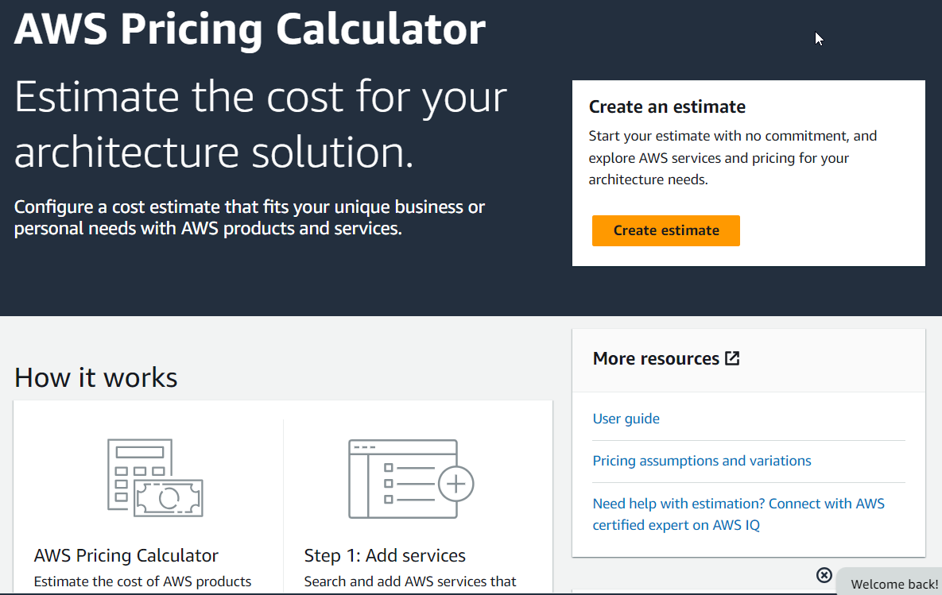
Capacity Planning
model-based
existing measurements
check SLAs
check latencies
check costs
check limits and quotas!

Slide 34
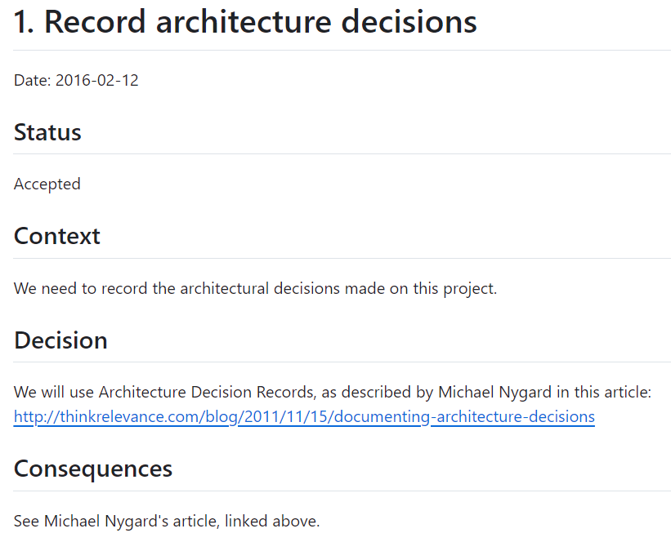
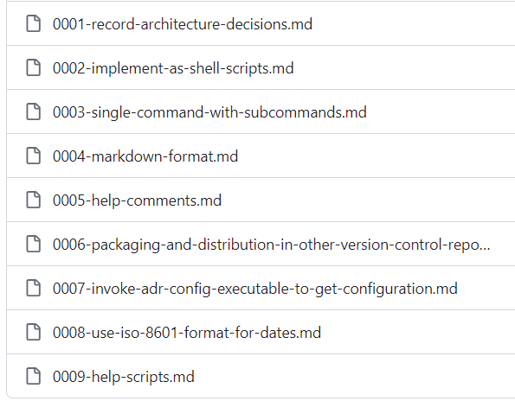
ADL & ADRs

Slide 35
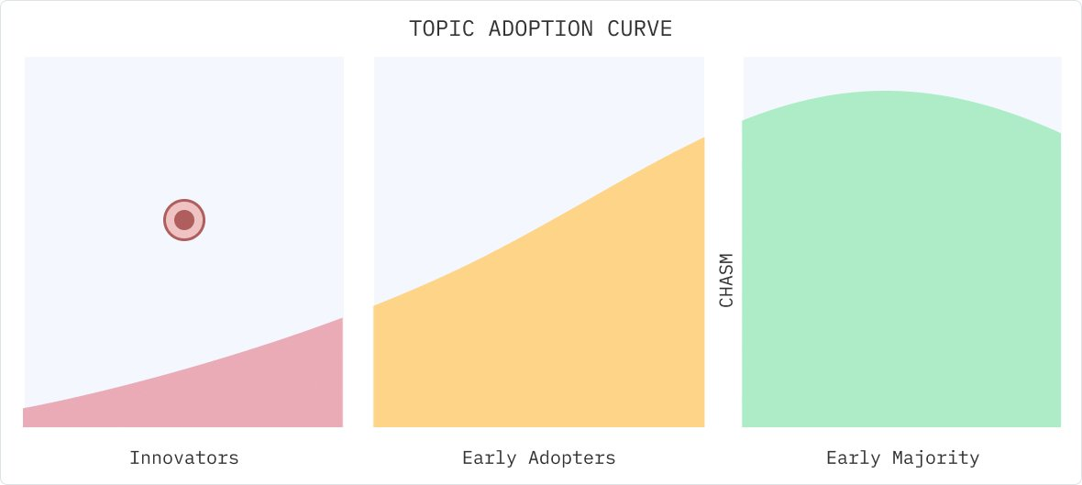
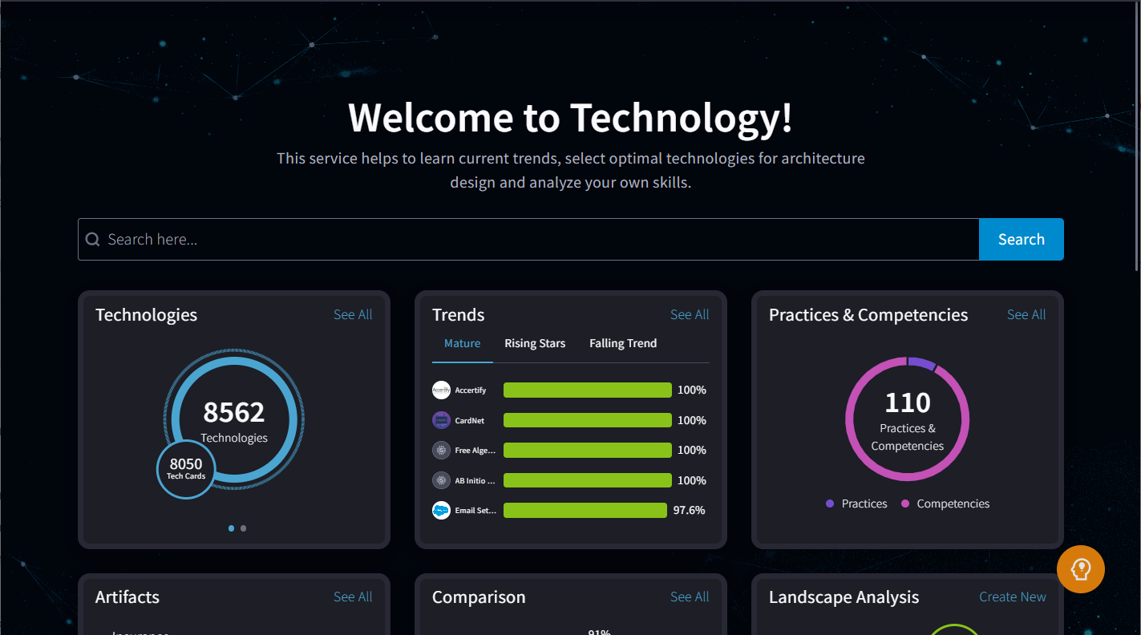
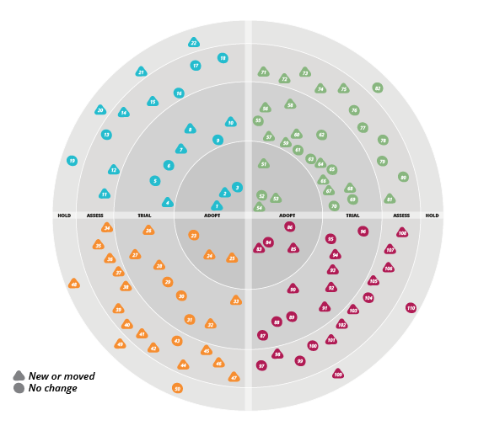
Tech Radar

Slide 36
… but this is about HOW
S
Notes:
POLL!!!

Slide 37
How do you make technical decisions? (32)
I'm using past project experiences - 63%
I'm using framework defaults - 9%
It's a well defined process - 3%
It's totally ad-hoc - 3%
It's architect / tech-lead 's call - 13%
"Stackoverflow it" and just include it in my PR - 3%
other (prefer not to tell) - 6%

Slide 38
Breadth-First

Slide 39
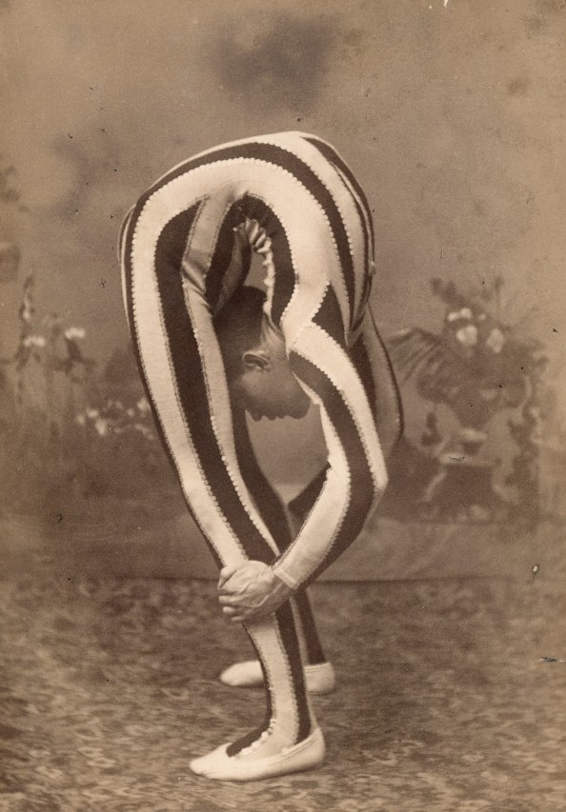
LEAN

Slide 40
LEAN
SET-BASED DESIGN
LAST RESPONSIBLE MOMENT
Notes:
Set-based design: “Deliver as fast as possible”
Last responsible moment: “Decide as late as possible”

Slide 41
Set-Based Design
Get me the …. (fastest, cheapest, easiest)
Branch
Combine

Slide 42
Set-Based Design
CHEAPEST
FASTEST
!
EASIEST
Notes:
Get me the …. (fastest, cheapest, easiest)
Branch
Combine
TODO: 1:30
OWN STORY: Workaround & Parallel in the last day of sprint.

Slide 43
Last Responsible Moment
parallel dependencies
interfaces & abstractions
feature toggles
deprecation
Notes:
OWN STORY: 3 DB implementation. Remove deprecated.
DevOps => sync up for solution. OPS side difficult / easy on DEV side

Slide 44

MISSING KEY INGREDIENT

Slide 45



Slide 46
Decision Making
Work as a team!
Use your intuition wisely
Remember: breadth-first
Be CALM & COLLABORATIVE
Notes:
OWN STORY: 3 DB implementation. Remove deprecated.
TODO: 2:00

Slide 47

Awesome Decision Making Recipe
Get away from computers
Pick 4-7 metrics
Brainstorm alternatives
Collect measures
Rate from 1-5
Disagreement LEAN
Notes:
TODO: 3:30

Slide 48

$$Σ$$
in

Slide 49
HOW
>
WHAT
IT’S NOT TECHNICAL

Slide 50
Q & A

Slide 51





Thank You!
Oresztész Margaritisz
@gitaroktato
gitaroktato
https://www.linkedin.com/in/oresztesz

Slide 52
References
How we decide (book summary)
Choose Boring Technology
Set-based design
How to make technical decisions given very little time?
Stackoverflow Insights
CVE Details
Analyzing code with SonarQube in Docker
Google Trends
Software Engineering Wisdom
Lean Tools: Making Decisions
Lean Tools: Options Thinking
Emotional Intelligence
Microsoft – Quality Attributes and Metrics
EPAM – Technology Radar
InfoQ – Technology Trends
Thoughtworks – Build Your Own Technology Radar

Slide 53
References
AWS Latencies #1
AWS Latencies #2
ADR Tools GitHub
Michael Nygard – Documenting Architecture Decisions
AWS Pricing Calculator
AWS SLA searck
AWS Reliability Pillar – Example implementation of availability goals
AWS Reliability Pillar – Definition of availability
gitaroktato – Microservices availability simulator
gitaroktato – Queue model in Python
TechEmpower – Web framework benchmarks

